Slide 1
Capstone Project Report: The Battle of Neighborhoods
By Joseph Harris

Slide 2
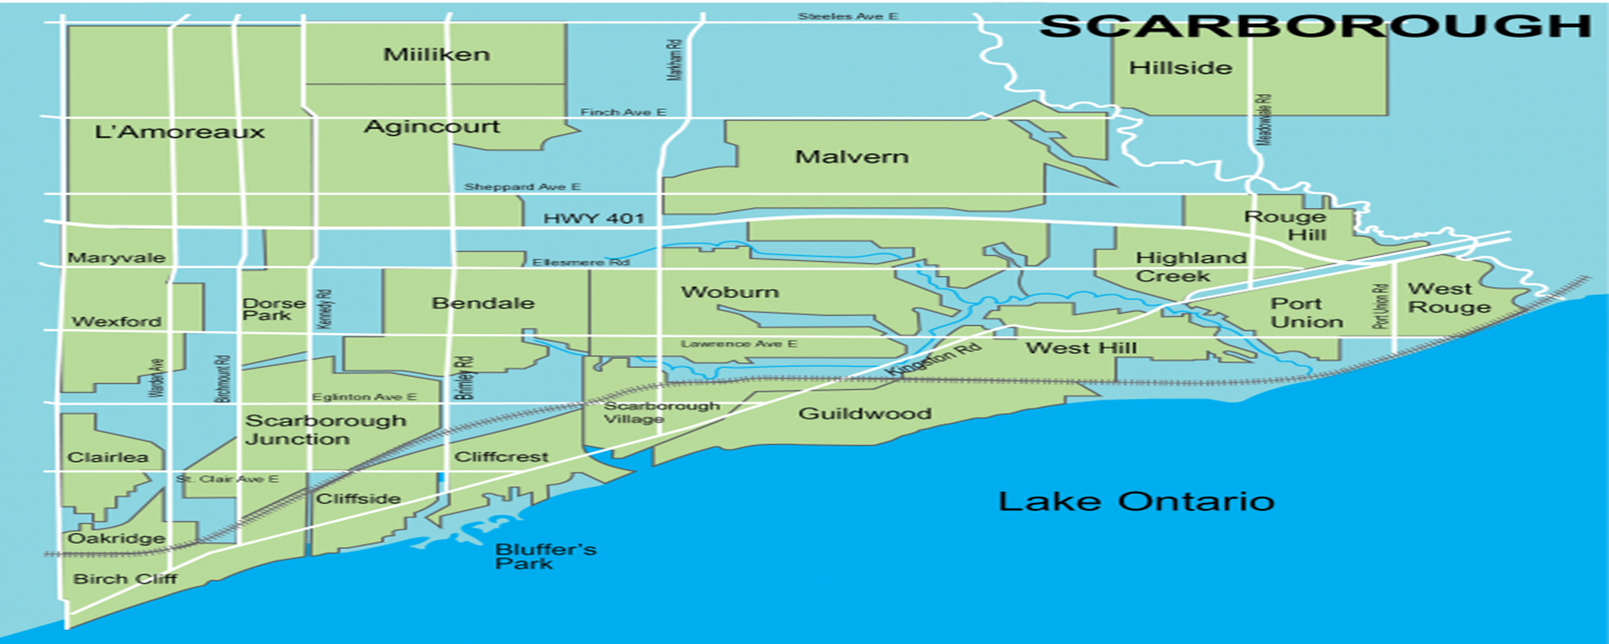
Finding the right Neighborhood in Toronto
In this project, we wish to help people find the best area to move to.
Specifically, we are looking into the neighborhoods of Scarborough, Toronto, Canada.

Slide 3
Data Gathering and cleaning
Toronto data gathered from Wikipedia article: https://en.wikipedia.org/wiki/List_of_postal_codes_of_Canada:_M
Foursquare used to gather information of venues, schools, and other necessities.

Slide 4
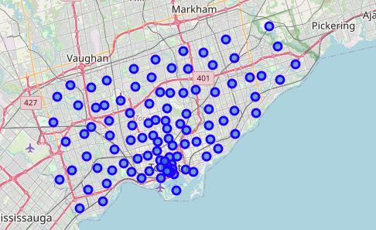
Neighborhoods in Toronto

Slide 5
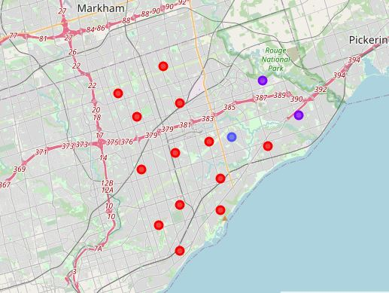
Map Clusters

Slide 6
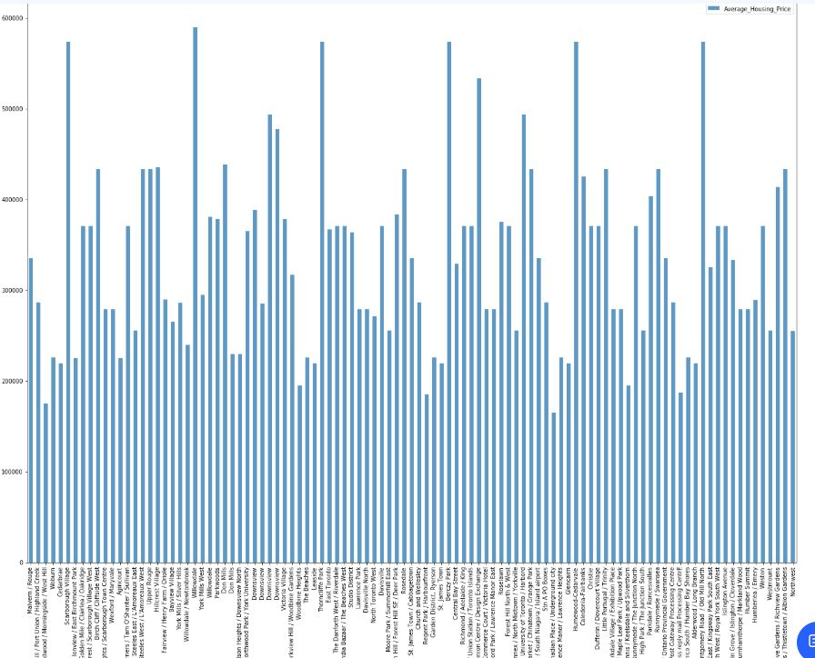
House Prices

Slide 7
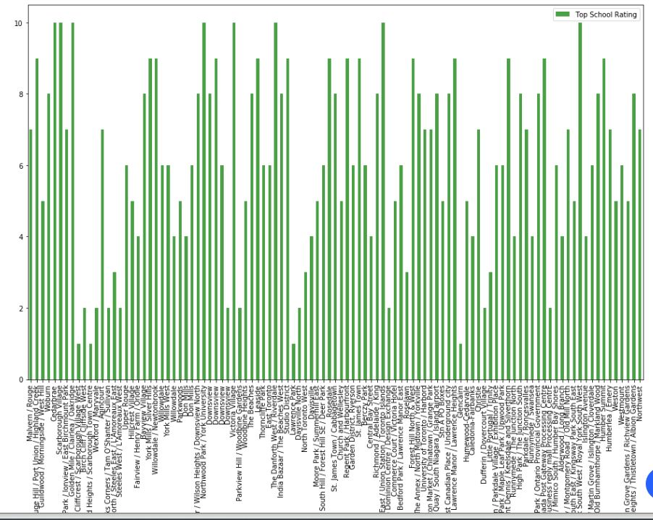
School Ratings

Slide 8
Conclusion
Using k-means cluster algorithm we have separated the neighborhood into ten different clusters for 103 different latitude and longitude from the dataset.
Using the charts we are able to get the best neighborhood based on average house prices and school ratings.

